Slide 1
Game Development 2B
Stacks and Queues

Slide 2

The point of stacks and queues
Data structure that models real life scenarios
1
Meaningful data organization
2
Stack is Last In First Out
3
Queue is First In First Out
4

Slide 3
stack
Items only accessible from end of a list
1
Top of stack
2
Pushing to a stack: Adding an item
3
Peeking at a stack: Returning the top item
4
Popping from a stack: Returning and removing an item
5

Slide 4
Other properties
Clear
Count
isEmpty

Slide 5
Creating a custom stack
An underlying data structure/linked list
Something to keep track of where items are in the list (where is the top of the stack?)

Slide 6

Custom stack

Slide 7
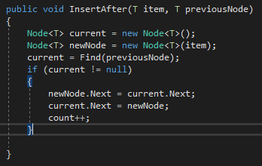
Fixing some linkedlist structures
Our LinkedList currently works on unique items
What is the problem with our current InsertAfter LinkedList code if we’re trying to insert at the tail of our list?

Slide 8
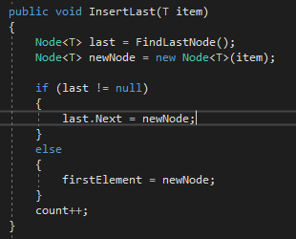
Creating insertlast in our linked list to insert at the tail
Insert(item) inserts at the head of our linked list
InsertLast(item) inserts at the tail

Slide 9
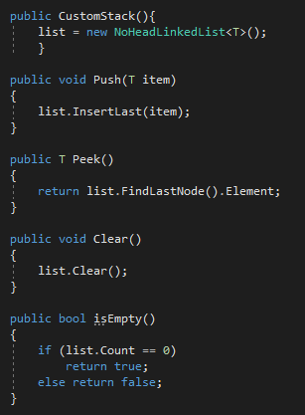
Basic customstack structures

Slide 10
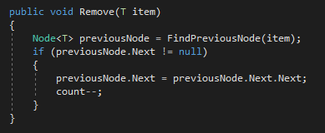
Popping from a stack
Finding our last node is easy
Based on our current LinkedList Remove method, what is the problem with removing the tail with a standard Remove() function?

Slide 11
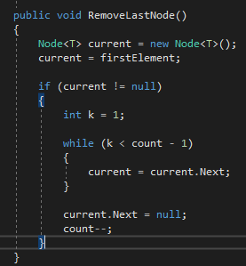
Popping from a stack - removelast
Our counter starts at 1, because there will always be one element in our list because it’s a NoHeader LinkedList
This makes sure we get the node before our actual last node (not based on the value of the item)
Redirects that pointer to null

Slide 12
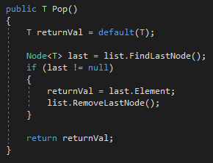
Pop functionality in customstack

Slide 13
Using stacks
Based on your understanding of stacks, how can we use this last in first out functionality in games?

Slide 14
queues
Data enters last
Removes first
First in first out
Models any waiting process

Slide 15
Queue methods
Enqueue
Dequeue
Peek
Clear
Count
isEmpty

Slide 16
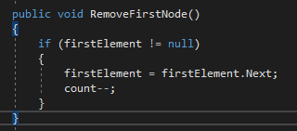
Changes to the linkedlist class
We have access to our header, but it’s read only access
We need a way to access the start of the list
RemoveFirst()
Reroute the header to up one in the list

Slide 17
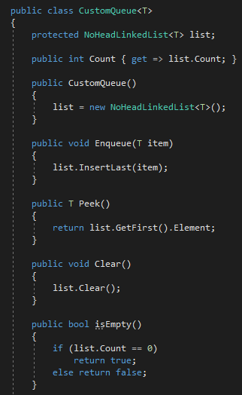
Basic queue methods

Slide 18
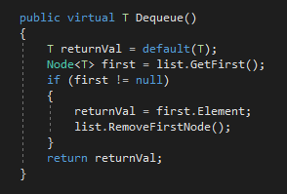
dequeue
Return the first node
Remove the node and refocus pointer
Virtual because overriding later

Slide 19
The priority queue
Extension of queue class
1
Assigns weights to each element
2
Inheritance so our original queue is not compromised
3
What additional elements do we need?
4

Slide 20
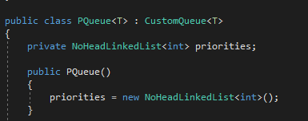
Priority queue
We need a parallel LinkedList for priorities

Slide 21
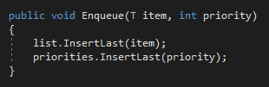
Parallel insert

Slide 22
Dequeue logic
How do we conceptually go about dequeuing an object in a Priority Queue?
Dequeue occurs by priority

Slide 23
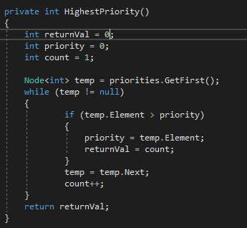
Determining highest priority
Loop through each item in the queue – mark its index, as well as its priority as “the current highest priority”
Move through the list marking highest priorities and matching indices until you can return the value of the highest index

Slide 24
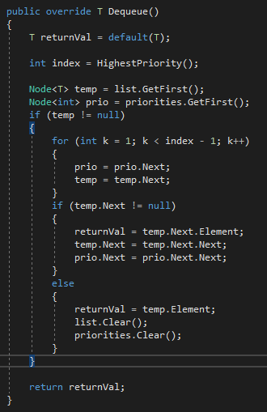
Removing the item from the middle of the queue by index
Track both the list and priority list
Loop to the previous node before the index
Start at 1 because we only loop if there’s an element
When you get to previousNode, reroute
If there’s no previous node, there must only be one item in the list – return it and clear the list

